Slide 1
Vaping and e-cigarettes
Grades 7-12

Slide 2
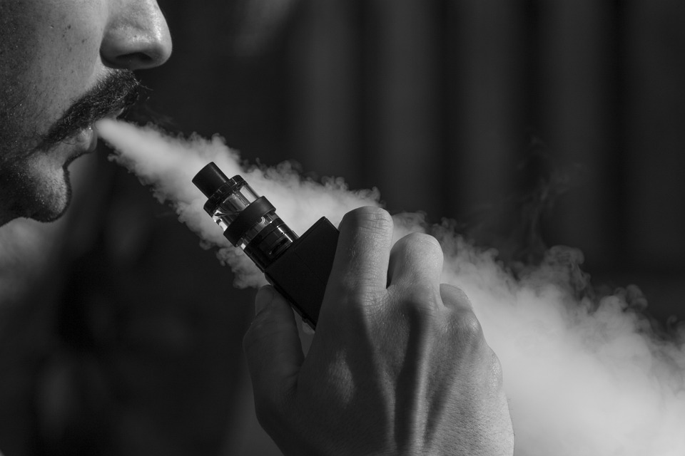
What is vaping?
Inhaling and exhaling aerosol from a vaping device^{1; 2}
Notes:
What is vaping? (Wait for responses. After hearing a few responses click and review slide).
Vaping is the act of inhaling and exhaling aerosol produced by a vaping device. These are sometimes called an e-cigarette. The aerosols they produce often contain nicotine, flavouring, and sometimes cannabis ^{1; 2}
Image: free from https://pixabay.com/photos/eliquid-ejuice-electronic-cigarette-3576069/

Slide 3
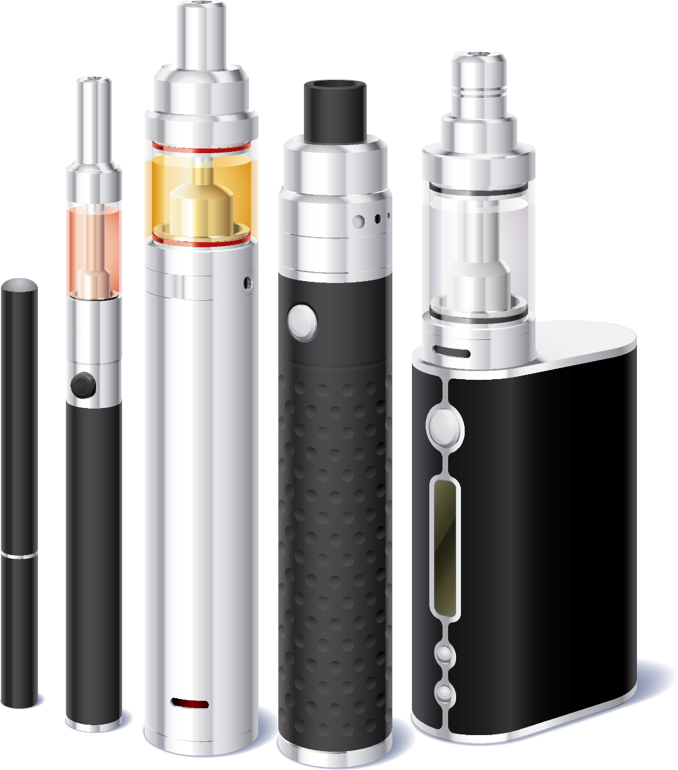
Electronic cigarettes and vaping products
Notes:
Vaping devices have many designs and different names. Examples include^{1; 2}:
Vapes
E-cigarettes or e-cigs
Sub-ohms
Vape pens or e-pens
Electronic nicotine delivery systems (ENDS)
Dab pens (used for ‘dabbing’ cannabis)
There are two kinds of vaping devices¹:
Open: can be refilled with vaping liquid
Closed: the whole product, or the part that holds the vaping substances, can’t be refilled.
Image: iStock-515644950 (purchased)

Slide 4
Components of a vaping device:
mouthpiece
liquid reservoir
heating element
battery
Notes:
Although vaping devices or e-cigarettes are all a bit different, most of them have a few common parts³ (click to reveal each part):
Mouthpiece: can be disposable, changeable, or have other attachments such as a tube or hose. Not all devices have a separate mouthpiece, (click)
Liquid reservoir: also called a cartridge, tank chamber, or pod. These are filled with liquid that may or may not contain nicotine, flavouring, or other substances such as cannabis extracts. The liquid is referred to as e-juice. (click)
Heating element: heats the liquid which then becomes vapour. The vapour condenses into an aerosol, that resembles smoke and gets inhaled click)
Battery: can vary in voltage and can be rechargeable.
To summarize, most vaping devices use battery power to heat up and vaporize a liquid. The vapour becomes aerosol that gets inhaled.
Image: iStock-515644960 (purchased)

Slide 5
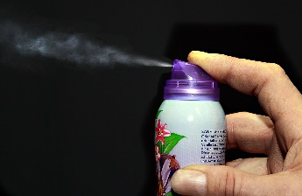
What’s the difference?
Vapour
a substance in a gaseous state
Aerosol
a suspension of particles (liquid, solid or both) in a gas
Notes:
Time for a science lesson!
We’ve been using the terms ‘vapour’ and ‘aerosol’ quite a bit. What is the difference between the two? (hear student responses)
(click) A vapour is a substance in a gas state⁴. An example of this is steam, which is the vaporized form of water when it gets heated up (click).
An aerosol is a suspension of liquid or solid particles within a gas⁴. Some examples of aerosols are hairspray and spray deodorant (click).
The substance which is inhaled from an e-cigarette is an aerosol. It contains liquid and solid particles that are suspended in the gas that’s produced when e-juice gets heated up⁴.

Slide 6
Why do you think people vape?
Notes:
With knowing more about what vaping is,, let’s explore some reasons why people might choose to vape or not. (Note: the reason this activity comes at this time is to prevent influencing their perception or answers of why people vape)
Lead class through Activity: Reasons why people vape https://www.phsd.ca/wp-content/uploads/2020/01/Activity_Reasons_why_people_vape_AODA_PRINT_EN.pdf
Image: Pixabay, ask-blackboard-356079 (free for use)

Slide 7
What do you think is in e-juice?
It is not just water vapour!
Notes:
Having reviewed reasons why people may or may not choose to vape, lets discuss what is being vaped.
What do you think is in e-juice? (pause and hear some responses, then click)
Do you think it is just water and flavouring?
(Hear some responses and then click)
It is not just water vapour! Although we cannot see the chemicals in the aerosol that is inhaled into the lungs, does not mean that it is safe or free from hazardous chemicals or particles.
Image: Pixabay, kettle-653673_1920 (free for use)

Slide 8
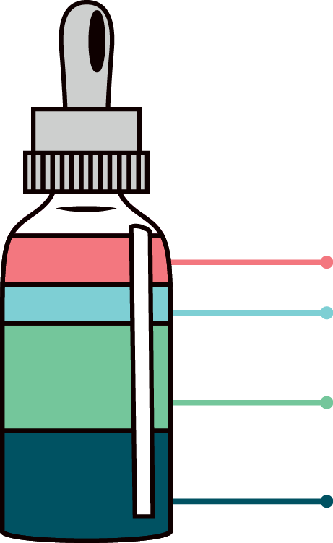
Vaping liquid (e-liquid, e-juice)
flavouring
nicotine
glycerin
propylene glycol
Notes:
The E-liquid, or e-juice that gets heated up by a vaping device typically consists of: (click)
A carrier solvent. this is a liquid used to dissolve the other active ingredients. Most e-juice uses propylene glycol and/or glycerol (also known as glycerin or vegetable glycerin)³(click)
Different flavourings made up of various chemicals³ (click)
Most (but not all) e-juice contains nicotine¹ The amount of nicotine varies from product to product, and the amount indicated on the label are not always accurate ^{4; 5 ;6} . One study found that liquids claiming to contain no nicotine can have nicotine present⁷.
Image: iStock-530209242 (purchased)

Slide 9
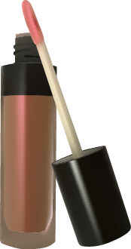
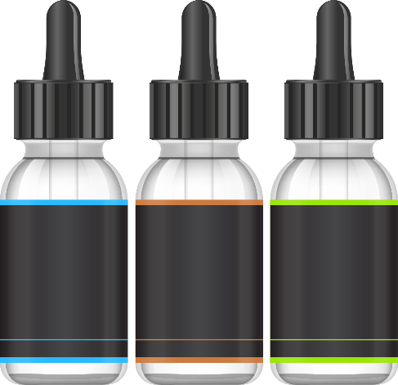
Where else are these ingredients?
glycerin
propylene glycol
flavouring
nicotine
Notes:
Where else might you find some of these ingredients that are in e-liquid? (click)
Glycerin is commonly used in cosmetic products like soaps and lip gloss, as well as many food products. (click)
Propylene glycol is a chemical used to make products such as antifreeze and paint solvents⁸. (click)
Chemicals used for flavouring in food products are also used to flavour e-juice⁹, (click)
Finally, nicotine is the highly addictive substance found in tobacco cigarettes.
While some of the chemicals used in e-liquid flavouring and solvents are safe to use in cosmetic products and to be eaten in foods, we don’t yet know if they are safe to inhale as an aerosol⁹
Image: iStock-935323952 (purchased)
Image: iStock-466542094 (purchased) Image: iStock-986438992 (purchased)
Image: Pixabay, cigarette-1271874_1920 (free for use)

Slide 10
Which of these chemicals are in e-cigarette aerosol?
formaldehyde
acrolein
nickel
tin
aluminum
propylene glycol
flavours
carbonyl compounds
volatile organic compounds (VOCs)
nicotine
glycerol
ALL OF THEM
Notes:
There are other chemicals found in aerosols many vaping devices produce. Which of the chemicals on this slide do you think have been found in the aerosol that gets inhaled through vaping? (wait for responses)
(Click) The answer is all of them. Some are already present in the e-liquid, with more formed during the process when the liquid is heated and turned into an aerosol⁵.
Many of these chemicals are also in tobacco smoke and have proven to be toxic or cause cancer^{5;} ⁸.

Slide 11
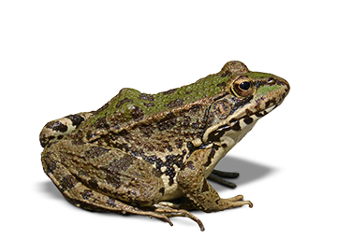
What are these chemicals?
Formaldehyde is in embalming fluid.
Acrolein is in pesticides.
Nickel, tin, and aluminum are heavy metals.
Notes:
What are some of these chemicals that are found? ^{5 ; 8}
Formaldehyde is a cancer-causing chemical used to preserve lab specimens. You may have seen specimens like frogs kept in a jar? This is the liquid that keeps them from decaying. This is used in the embalming process after someone has died and before the deceased is placed in a casket.
Acrolein is a biocide or pesticide, formed from the breakdown of glycerol during the heating process.
Nickel, tin, and aluminum are heavy metals. When a vape device is activated the heat may cause bits of particulate matter from the metal of the chamber or heating element to be released.
Image: Pixabay, jar-162166_1280 (free for use) Image: Pixabay, frog-1445824_1920 (free for use)
Image: Pixabay, herbicide-587589_1920 (free for use) Image: iStock-92092227 (purchased)

Slide 12
Do you think vaping is safe?
Notes:
Do you think that vaping is safe? (listen to responses)
------------------------------
Image: Pixabay, ask-blackboard-356079 (free for use)

Slide 13
Less harmful does not mean safe
long-term risks unknown
viruses and infectious diseases¹²
e-liquid can be poisonous
nicotine is addictive
Notes:
Some advertisements claim that vaping is less harmful than smoking, but just because something may be less harmful does NOT mean that it is safe.
Let’s be clear: Vaping is not harmless. Evidence of potential health effects is sufficient to suggest that anybody who is not a current smoker of tobacco cigarettes should not vape electronic cigarettes.¹⁰
Since vaping is relatively new compared with smoking tobacco, we don’t yet know all of the short and long-term effects. So far, we do know that:
Chemicals inhaled while vaping can damage the lungs and cause or exacerbate breathing
problems¹¹
Vaping e-juice may have enough nicotine to be poisonous to young children if swallowed or absorbed by the skin⁹.
Besides nicotine, vapour produced from an e-cigarette can contain and other heavy metals ^{­5}.
If you share vaping devices there is a risk of spreading viruses and infectious diseases ¹²
E-juice used in electronic cigarettes and vaping products often contain nicotine, which is addictive. We will discuss more about this shortly .
Evidence suggests youth who vape may be more likely to become tobacco smokers.¹³
The health effects of vaping should not be compared to the health effects of smoking, but rather compared to not vaping.
Considering these chemicals and what is known in terms of the health effects, do you think that vaping is safe, compared to not vaping?
Image: Pixabay, sign-304093_1280 (free for use)

Slide 14
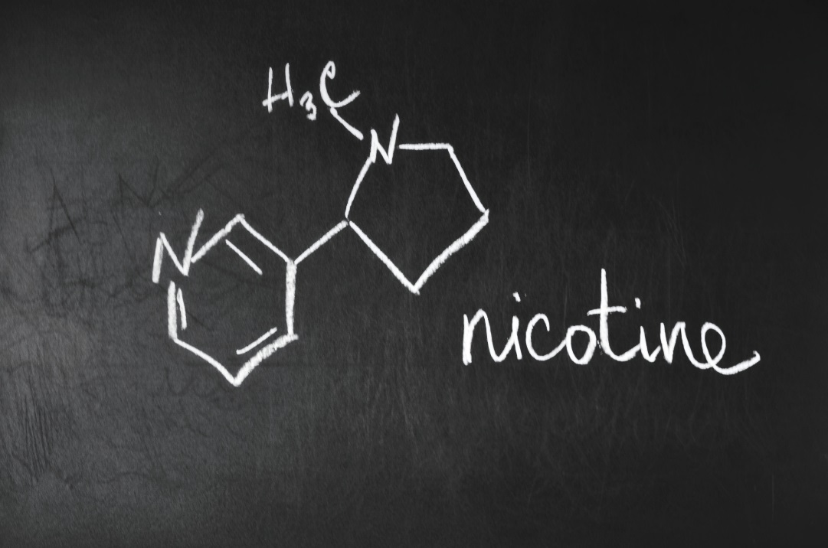
Notes:
We know that most e-liquids contain nicotine.
But what is nicotine?
Nicotine is found naturally in the tobacco leaf¹⁴ and is added to the e-liquid used in the vape.
--------------------------------------
Image: iStock-856809470 (purchased)

Slide 15
How it works: from liquid to vapour
Image: Government of Canada (2019). Vaping: The Mechanics (infographic). Available: https://www.canada.ca/en/services/health/publications/healthy-living/vaping-mechanics-infographic.html.
Notes:
Earlier we looked at the e-cigarette components and e-liquid, and how the aerosol is created that is inhaled. Now let’s discuss how the aerosol enters and exits the body. (click)
How it works³:
Vaping liquid (aka e-liquid), which contains chemicals, is heated to become an aerosol. (click)
The aerosol is inhaled through the mouth and lungs where its contents get absorbed into the bloodstream. (click)
The remaining aerosol is exhaled.

Slide 16
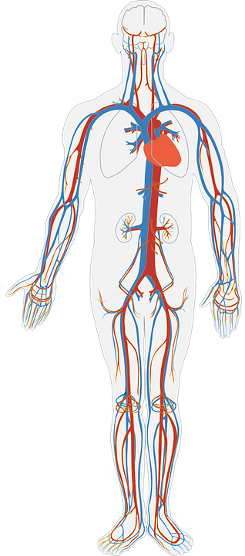
Effects of nicotine within 10 seconds
Notes:
Once the aerosol is inhaled into the lungs, it can take as little as 10 seconds for nicotine to reach the brain¹⁵.
This causes several reactions in the body that are immediate¹⁵: (click)
Increased heart rate and blood pressure.(click)
Blood vessels constrict, causing a temperature drop in the hands and feet. (click)
Brain waves are altered, and muscles relax.
Image: Pixabay, stopwatch-161539_1280 (free for use)
Image: Pixabay, heart-1143648_1920 (free for use)
Image: Pixabay, human-body-311864 (free for use) Image: iStock_618611610 (purchased)

Slide 17
Nicotine
affects brain development
affects memory and concentration
is addictive
“Teen brains aren’t wired like adult brains”
~Parent Action on Drugs
Notes:
There are also other effects of nicotine, especially on the developing brain of youth. This is because the adolescent brain is built to process a lot faster than the adult brain, to learn and adapt to its surroundings. When nicotine is introduced, it. alters this brain development, and also affects memory and concentration⁹ (click).
Nicotine is a highly addictive substance (click). With the speed at which the youth’s brain is processing, it also means they may become dependent on nicotine at lower levels of exposure than adults⁹. As previously mentioned, research suggests young people who vape may be more likely to start smoking tobacco cigarettes.
Addiction¹⁴:
Addiction means that a person cannot control their use of a substance. They will use it despite harmful consequences.
Nicotine may cause a person to temporarily feel good or energized. It causes the release of natural chemicals in the brain that may make a person feel more alert and calmer.
Over time, the body builds a tolerance to some of the effects of nicotine and the person must therefore continue to vape or smoke to make the effects last.
When someone who vapes or smokes regularly goes without nicotine for a prolonged period, they often experience withdrawal symptoms such as irritability, anxiety, trouble sleeping, headaches, and cravings. Many people continue to vape or smoke to avoid these symptoms.
Image: iStock_000043608806 (purchased)

Slide 18
How does nicotine addiction work?
https://www.youtube.com/watch?v=uFX9F-KD7co
Notes:
https://www.youtube.com/watch?v=uFX9F-KD7co
Here is a video to explain a little better about how addiction to nicotine works.
-----------------------------------------------------------------
Image: Pixabay, nobody-2798850_1920 (free for use)

Slide 19
Can a person overdose on nicotine?
Notes:
How much nicotine is too much? This can vary from person to person and is based on how much nicotine the body is used to consuming, and how often.
If liquid nicotine is consumed by drinking or absorbed through the skin it can be poisonous, causing nausea or vomiting, a fast heartbeat, jitteriness and shakiness, difficulty breathing, seizures, or even lead to death,¹⁵ especially for a young child. This is an important fact to consider if there are young children in a home, such as younger siblings, when babysitting, or with pets.
How many of you have younger siblings or have babysat? (wait for students to raise hands)
How many times have you seen one of those children find and take something that looks neat or delicious without asking and play with it or put it in their mouth? (allow students to respond)
You can see how dangerous these e-liquids can be, especially with fun, fruity or candy flavours.
Image: Pixabay, ask-blackboard-356079 (free for use)

Slide 20
Sharing is not caring
Notes:
Sharing anything by mouth, including vaping devices, can increase the risk of spreading viruses or infections¹².
Even though if a a disposable tip is utilized used, it may not prevent the transmission of contagious diseases¹².
Image: iStock_1016599046 (purchased)

Slide 21
Notes:
A young person who starts smoking could become a lifelong customer to the tobacco industry.¹⁶
Public health campaigns have helped to increase awareness of the negative health effects of tobacco cigarettes over the past several decades, and smoking rates have significantly declined¹⁷. Some companies producing vaping devices are now owned by multinational tobacco companies.¹⁸
Vaping products that contain nicotine are sometimes suggested as potential tools to help adults quit smoking despite the current lack of conclusive evidence that they are effective for this. Emerging evidence has shown that vaping may increase the likelihood that a young person will start smoking tobacco.¹⁹
A main reason for marketing is to sell more product to more people.
Governments are now taking steps to regulate marketing and protect the health of young people²⁰
Be critical of advertisements you may see in stores, the internet, and on social media.
Image: Pixabay, interaction-1233873_1920 (free for use)

Slide 22
Legal considerations
Minimum age to purchase e-cigarettes, vaping devices, or vaping products is 19.
Illegal to sell or provide to anyone under this age
Could face financial and other consequences
Even if the e-cigarette is only activated!
Notes:
You will have noticed the signs entering your school, you are not able to smoke or vape in the school or on the property²¹ You also cannot vape on public areas withing 20 metres of school grounds.²²
What is the legal age to purchase e-cigarettes, vaping devices, or vaping products? (wait for a few responses)
(Click)
As per The Smoke Free Ontario Act, it is illegal to sell or provide e-cigarettes, vaping devices, or vaping products to someone under the age of 19.
(Click)
People who violate the Smoke Free Ontario Act by selling to people underage or those who use a vaping device in a prohibited place such as schools may be subjected to hefty fines. It’s important to note that you don’t have to be caught inhaling from a vaping device to be fined – merely holding an activated vaping device in a prohibited location counts as a violation.
Image: Pixabay, gavel-568417_1920 (free for use)

Slide 23
It is easier to say no now, than to quit later.
How can you say no?
Let’s go for a run instead.
I can’t, I have asthma.
No thanks, hey remember that time…
I have to
get back to class.
See you later!
A real friend wouldn’t pressure me.
Notes:
It is easier to avoid vaping and say no now than to quit later. If you’ve already started vaping or smoking, it’s never too late to stop.
If a person doesn’t want to vape, and it is offered to them or they are pressured, what are some different ways that a person can say no?
(Record the responses on flip chart paper or smart board.)
*When completed, (click), and review items on slide adding to their suggestions.²³
Use humor or change the subject.
Say you have a health issue like asthma, or say you want to stay healthy.
Tell them real friends don’t make you do things you don’t want to.
Suggest a different activity that doesn’t involve vaping or other substances.
Leave the situation.
Role Play:
Ask two students to improvise a situation where they would be asked or offered to vape and to have the student respond. Then ask the class for feedback.
OR
Refer to Activity: Refusal skills for vaping and e-cigarettes https://www.phsd.ca/wp-content/uploads/2020/01/Activity_Refusal_skills_for_vaping_AODA_PRINT_EN.pdf

Slide 24
Notes:
Discovering and exploring our interests and passions are ways we can build our resiliency and thrive in life. They help us build relationships with others and connect us to our community. Our passions are those things in life that make us light up with joy when we talk about them or allow us to lose sense of time when we are engaged in them. They can also help us focus on the positive things in life that we need to feel happy and fulfilled.
Our passions can help us define who we are and identify what is important to us. By nurturing or practicing them on a regular basis as part of self-care, our passions can become a positive coping strategy when needed and can help us make positive choices about our health and well-being when we are faced with adversity and life’s challenges.
Whether it be to avoid circumstances where you will have to say no, or to distract yourself from the urge to vape, finding and following your passion can help.
What are some activities or subjects you are passionate about and make you feel positive or fulfilled? (allow for responses)
Image: iStock_520658842 (purchased)
Image: guitar, StockSnap_A3CWF4P1RR (free for use)
Image: 2 people stretching, StockSnap_LXIA63985D (free for use)
Image: Pixabay, rainbow-657382_1280 (free to use)
Image: Family sunset, StockSnap_6ZYX4YY4IR (free to use)
Image: iStock_936973826 (purchased)

Slide 25
Need help or support?
Talk to a trusted adult (teacher, coach, parent)
Visit a nurse practitioner or family doctor
Call Public Health Sudbury & Districts Quit Smoking Clinic, 705.522.9200 ext 3433 (toll-free: 1.866.522.9200 ext 3433)
Call Kids Help Phone 1.800.668.6868 or text CONNECT to 686868

Slide 26
References
Government of Canada (2022). About vaping. Retrieved from https://www.canada.ca/en/health-canada/services/smoking-tobacco/vaping.html
Centers for Disease Control and Prevention. E-cigarettes, or vaping, products visual dictionary. Retrieved September, 2022 from https://www.cdc.gov/tobacco/basic_information/e-cigarettes/pdfs/ecigarette-or-vaping-products-visual-dictionary-508.pdf
Government of Canada (2019). Vaping: The mechanics (infographic). Retrieved from https://www.canada.ca/en/services/health/publications/healthy-living/vaping-mechanics-infographic.html.
Cheng, T. (2014). Chemical evaluation of e-cigarettes. Retrieved from https://www.ncbi.nlm.nih.gov/pmc/articles/PMC3995255/

Slide 27
References
National Academies of Sciences, Engineering, and Medicine (2018). Public health consequences of e-cigarettes. Retrieved from https://www.ncbi.nlm.nih.gov/books/NBK507171/.
Buettner-Schmidt, K., Miller, D., Balasubramanian, N. (2016). Electronic cigarette refill liquids. Retrieved from https://nebraska.pure.elsevier.com/en/publications/electronic-cigarette-refill-liquids-child-resistant-packaging-nic.
Hutzler, C., Paschke, M., Kruschinski, S., Henkler, F., Hahn, J., Luch, A. (2014). Chemical hazards present in liquids and vapors of electronic cigarettes. Retrieved from https://www.ncbi.nlm.nih.gov/pubmed/24958024.
American Lung Association (2020). What’s in an E-cigarette? Retrieved from https://www.lung.org/quit-smoking/e-cigarettes-vaping/whats-in-an-e-cigarette

Slide 28
References
Government of Canada (2019). Risks of vaping. Retrieved from https://www.canada.ca/en/health-canada/services/smoking-tobacco/vaping/risks.html#a2.
Centre for Addiction and Mental Health (n.d). As e-cigarettes evolve, researchers track a moving target. Retrieved from: https://www.camh.ca/en/camh-news-and-stories/ecigarettes.
Simcoe Muskoka District Health Unit (2020). Not an experiment: health effects of vaping. Retrieved from https://www.notanexperiment.ca/health-effects-and-addiction-alert/
Ontario Agency for Health Protection and Promotion (Public Health Ontario), Hui-Chih Wu J. Evidence brief: Communicable disease impacts of sharing electronic-cigarettes with drip tips. Toronto, ON: Queen’s Printer for Ontario; 2014.

Slide 29
References
Centers for Disease Control and Prevention (2022). Quick Facts on the Risks of E-cigarettes for Kids, Teens, and Young Adults. Retrieved from https://www.cdc.gov/tobacco/basic_information/e-cigarettes/Quick-Facts-on-the-Risks-of-E-cigarettes-for-Kids-Teens-and-Young-Adults.html
Government of Canada (2013). Nicotine addiction. Retrieved from https://www.canada.ca/en/health-canada/services/smoking-tobacco/effects-smoking/smoking-your-body/nicotine-addiction.html.
Centers for Disease Control and Prevention (2011). NICOTINE: Systemic agent. Retrieved from https://www.cdc.gov/niosh/ershdb/emergencyresponsecard_29750028.html.
Addiction Prevention Coalition (2021). Marketing To The Youth Of America: How Big Tobacco Leveraged Advertising To Reach Young People. Retrieved from https://apcbham.org/2021/01/11/marketing-to-the-youth-of-america-how-big-tobacco-leveraged-advertising-to-reach-young-people/

Slide 30
References
Dai X, Gakidou E, Lopez AD (2022). Evolution of the global smoking epidemic over the past half century: strengthening the evidence base for policy action. Tobacco Control 2022;31:129-137. Retrieved from https://tobaccocontrol.bmj.com/content/31/2/129.info
National Center for Chronic Disease Prevention and Health Promotion (US) Office on Smoking and Health (2016). E-Cigarette Use Among Youth and Young Adults: A Report of the Surgeon General [Internet]. Atlanta (GA): Centers for Disease Control and Prevention (US); 2016. Table 1.1, Multinational tobacco companies with e-cigarette brands. Available from: https://www.ncbi.nlm.nih.gov/books/NBK538684/table/ch1.tab1/
Al-Hamdani M, Manly E (2021). Smoking cessation or initiation: The paradox of vaping. Prev Med Rep. Mar 23;22:101363. doi: 10.1016/j.pmedr.2021.101363. PMID: 33868902; PMCID: PMC8044675.

Slide 31
References
Government of Canada (2020). Health Canada confirms ban of advertising for vaping products wherever they can be seen or heard by youth. Retrieved from https://www.canada.ca/en/health-canada/news/2020/07/health-canada-confirms-ban-of-advertising-for-vaping-products-wherever-they-can-be-seen-or-heard-by-youth.html
Government of Ontario (2017). Smoke-Free Ontario Act, 2017. Retrieved from https://www.ontario.ca/laws/statute/17s26/v1.
Ontario Ministry of Health (2021). Where you can’t smoke or vape in Ontario. Retrieved from https://www.ontario.ca/page/where-you-cant-smoke-or-vape-ontario
Royal Canadian Mounted Police (2018). Illegal Drugs. Retrieved from http://www.rcmp-grc.gc.ca/cycp-cpcj/dr-al/illd-dill-eng.htm.

